Slide 1
Who are you, doggy?
Team 33

Slide 2
Introduction

Slide 3
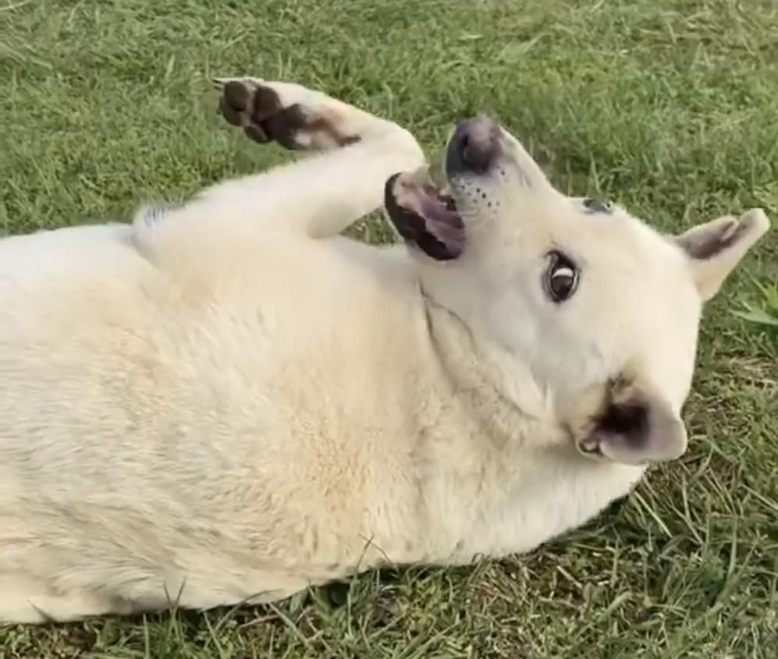
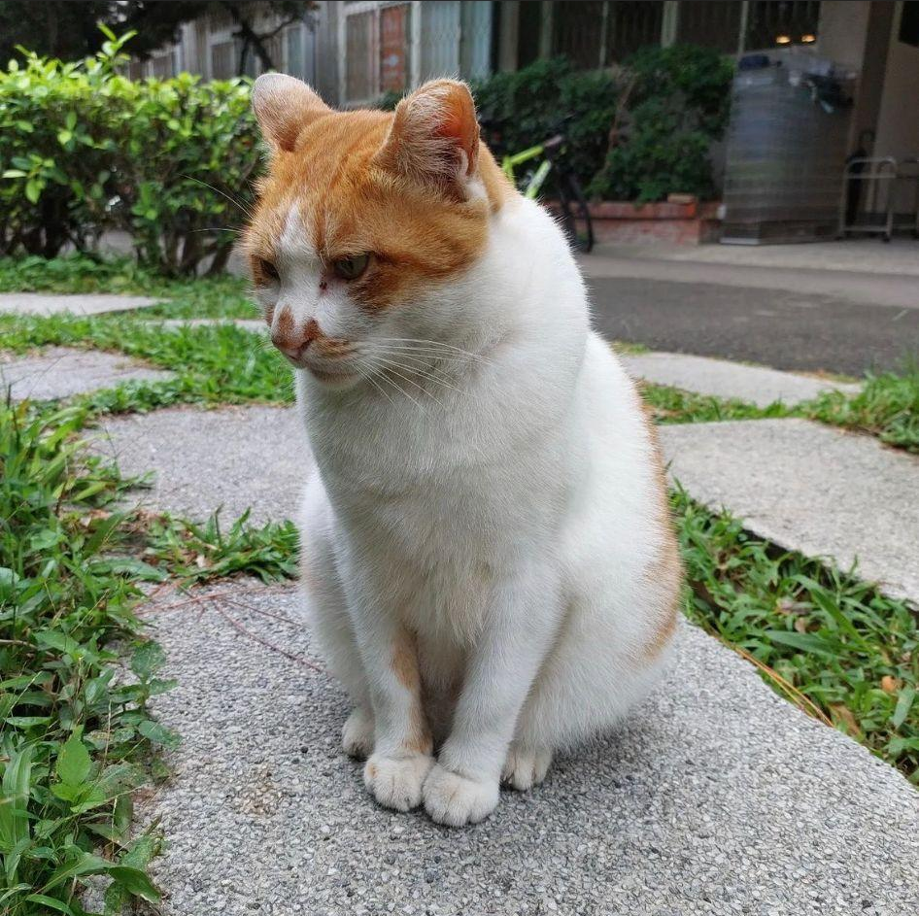
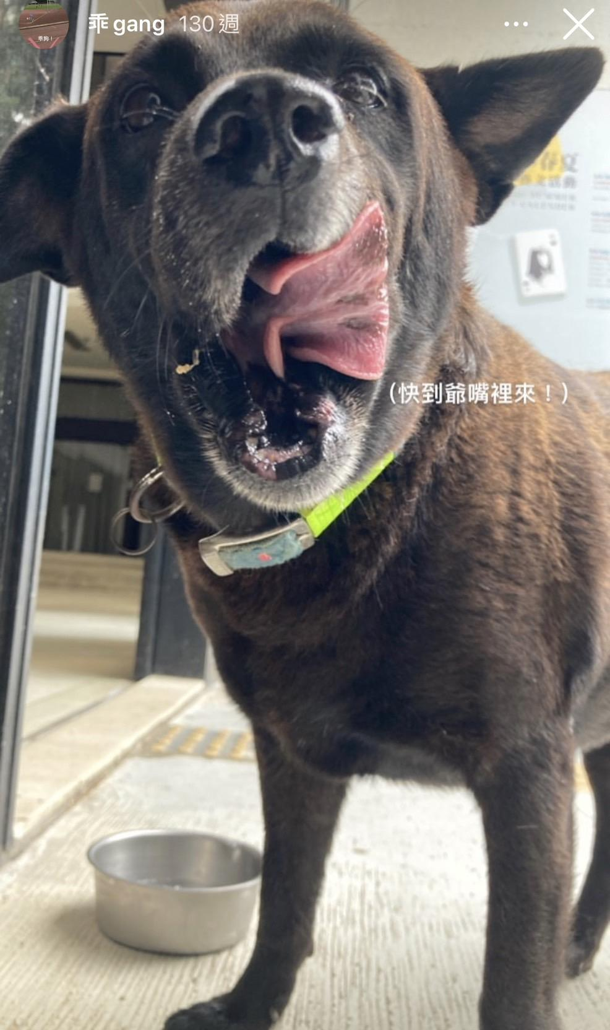
Introduction
There are many cute animals in NTHU.
But do you guys know their names?

Slide 4
Introduction
There are many cute animals in NTHU.
But do you guys know their names?
小白
森森
乖狗

Slide 5
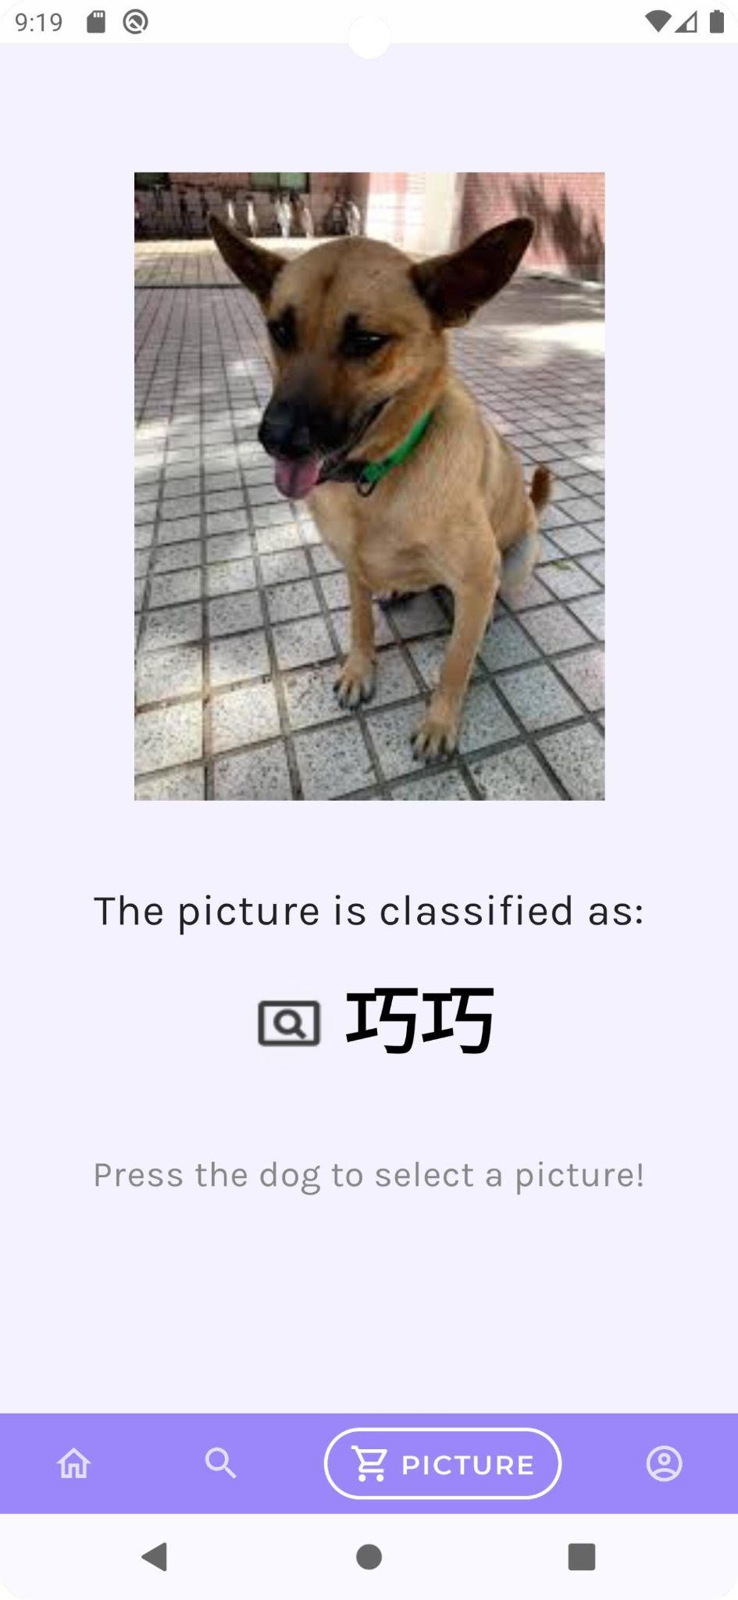
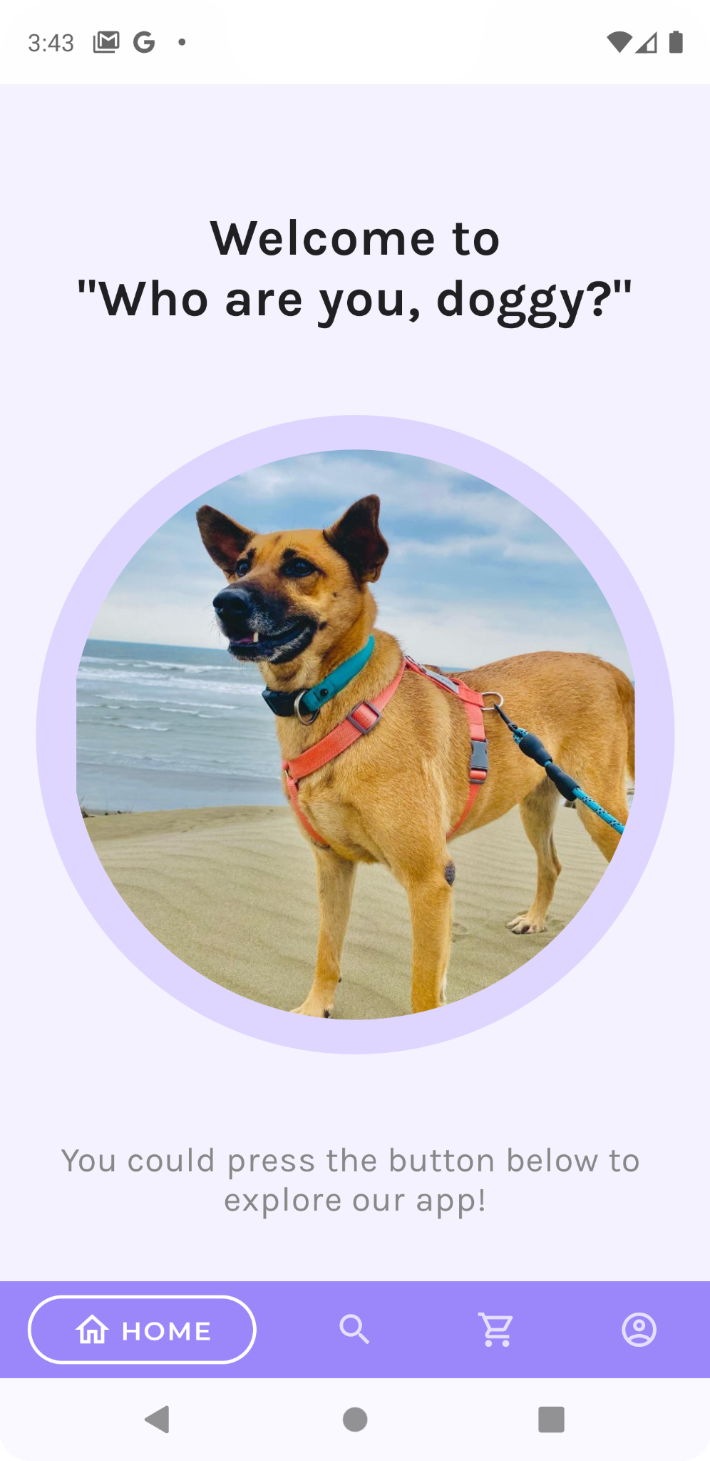
Introduction
Build an app to help people identify them.
Use smartphone, take a photo, and our app will tell
you who is it.

Slide 6
Implementation

Slide 7


Implementation
Prediction
Model
Convert to
tflite file
Call function
training
Convert to
tensorflow bufferarray

Slide 8
Data collection
& Data preprocess

Slide 9
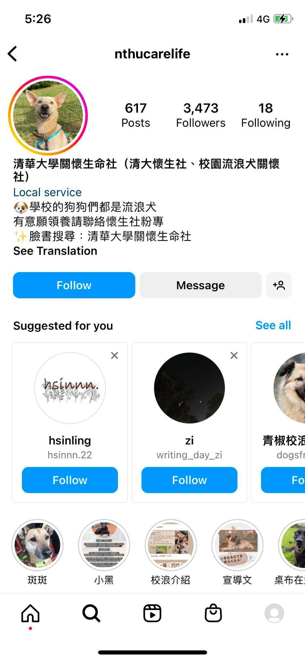
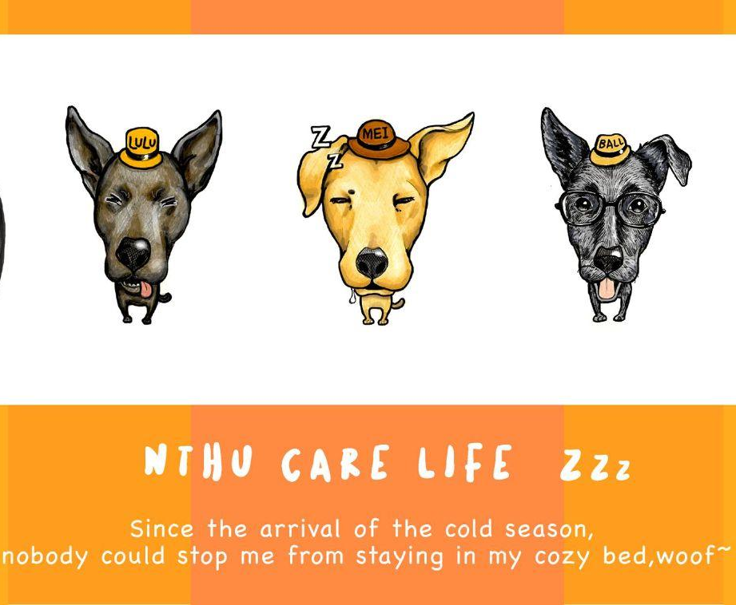
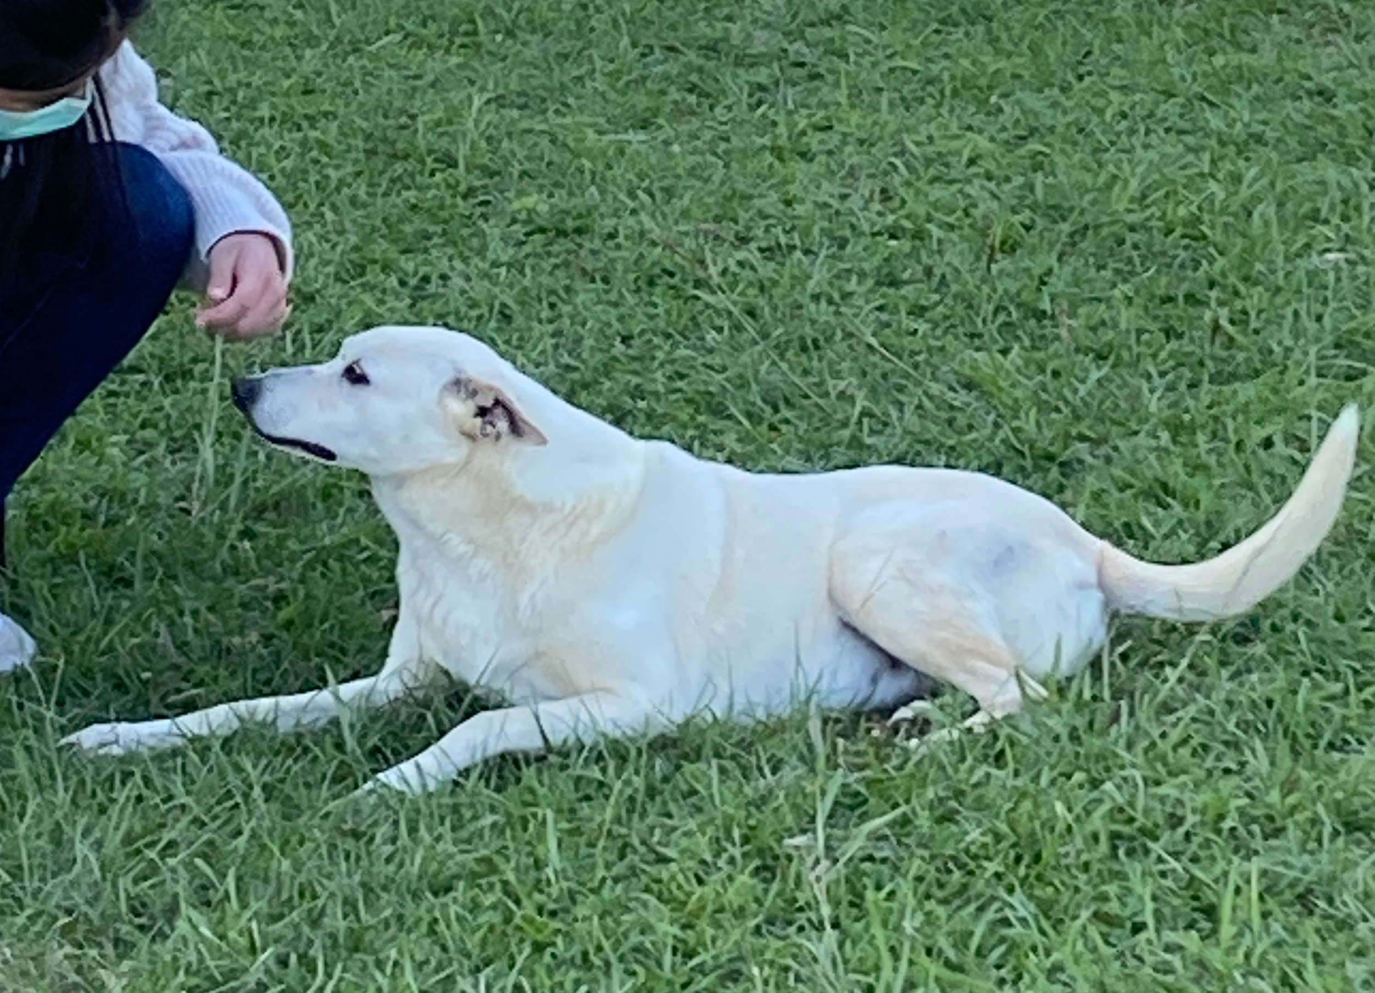
Data collection
11 classes
1510 photos totoally
Take photos by ourselves(Main source)
IG account
FB club

Slide 10
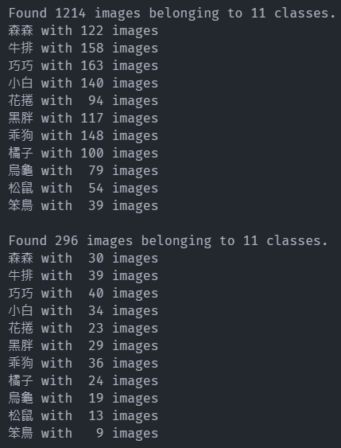
Data preprocess
Split data
Total: 1500 images
80% for training(1214), 20% for validation(296)
Augmentation
Horizontal_flip = True
width_shfit_range = 0.1
height_shfit_range = 0.1

Slide 11
Model

Slide 12
Model
Base model: MobilenetV2
Proposed by Google in 2018
Why do we choose MobilenetV2?
light-weight
smaller file size
faster CPU computation
less memory
So we can load our model to the mobile devices, otherwise our app may run too slow

Slide 13
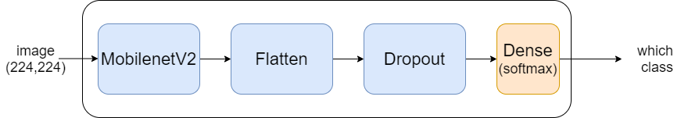
Model
Input: 224 * 224 images
Structure:

Slide 14
Training

Slide 15
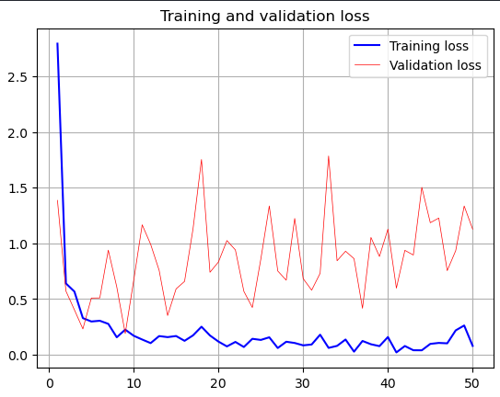
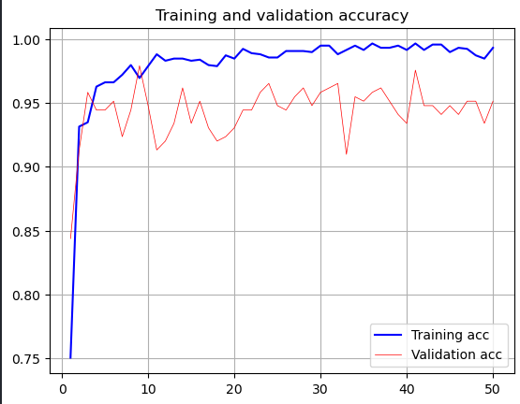
Training
Loss curve:
Optimizer: Adam
Loss: CategoricalCrossentropy
Epoch: 50
Batch size: 32
Accuracy curve:

Slide 16
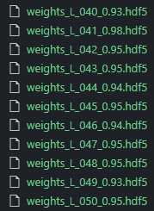
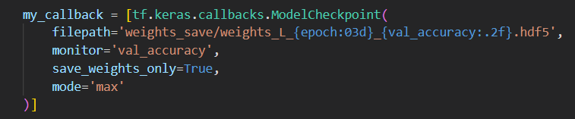
Training
Use tf.keras.callbacks.ModelCheckpoint
to store the weights(model) at every epoch
And then choose the best model
50 models in total

Slide 17
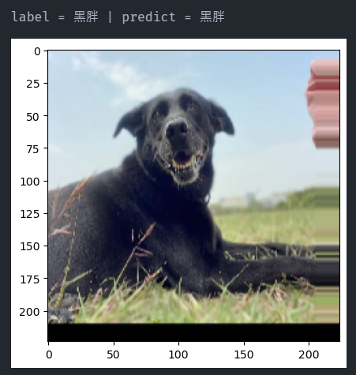
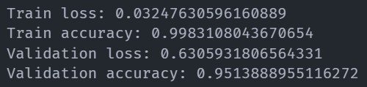
Training
Loss curve:
Optimizer: Adam
Loss: CategoricalCrossentropy
Epoch: 50
Batch size: 32
Accuracy curve:

Slide 18
Comparision

Slide 19
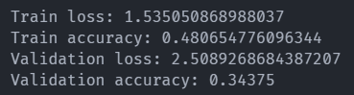
Comparision - Accuracy
MobilenetV2 VS MobilenetV3Large
Better!!

Slide 20
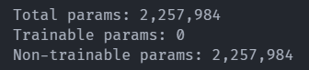
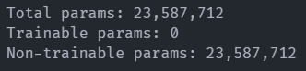
Comparision - Number of parameters
MobilenetV2 VS ResNet50
10 times less!!

Slide 21
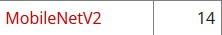
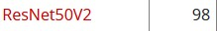
Comparision - Size & Speed
MobilenetV2 VS ResNet50
Size:
MB
MB
Speed:
25.9 ms/step
45.6 ms/step
More efficient!

Slide 22
Connect to Android

Slide 23
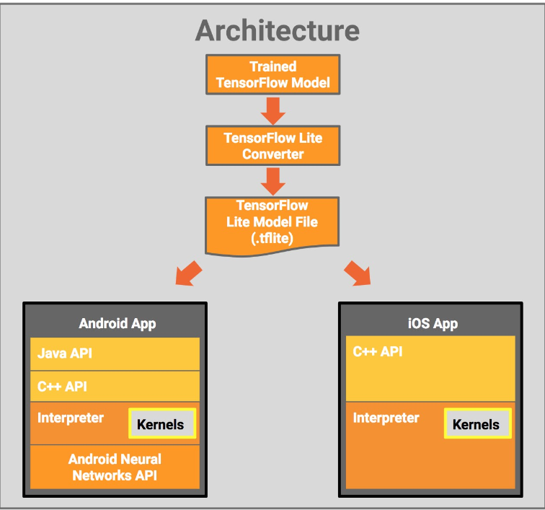
Connect to Android
Cannot use TensorFlow Model directly
Instead, use TensorFlow Lite
a light-weight mobile library for deploying models on
mobile and other edge devices.

Slide 24
Demonstration

Slide 25
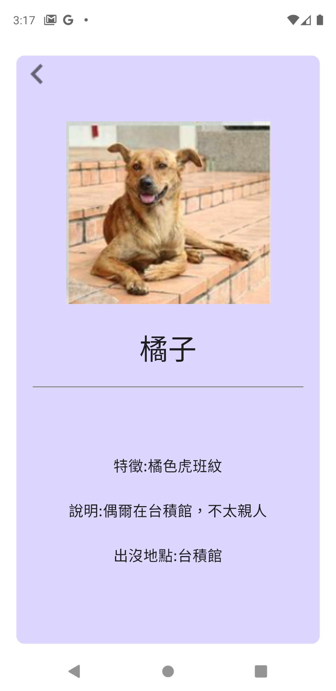
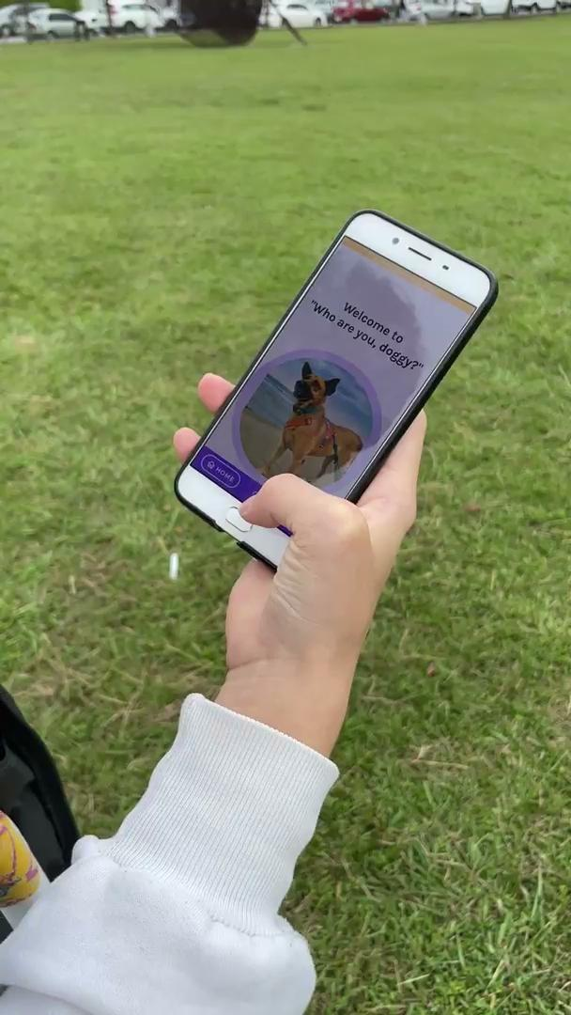
Demonstration

Slide 26
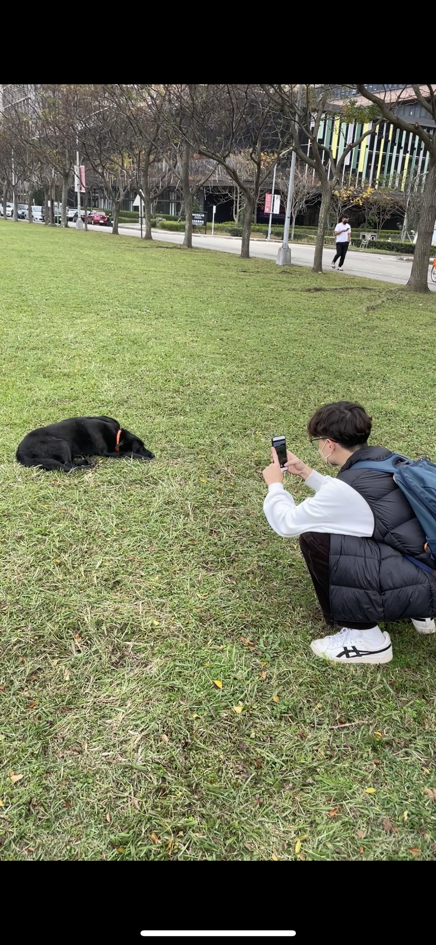
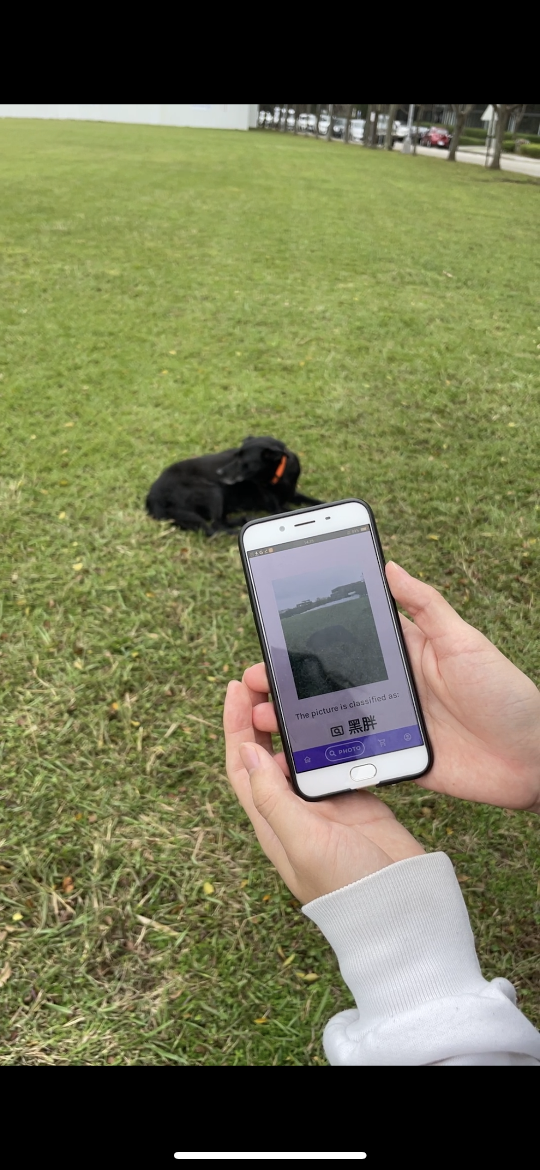
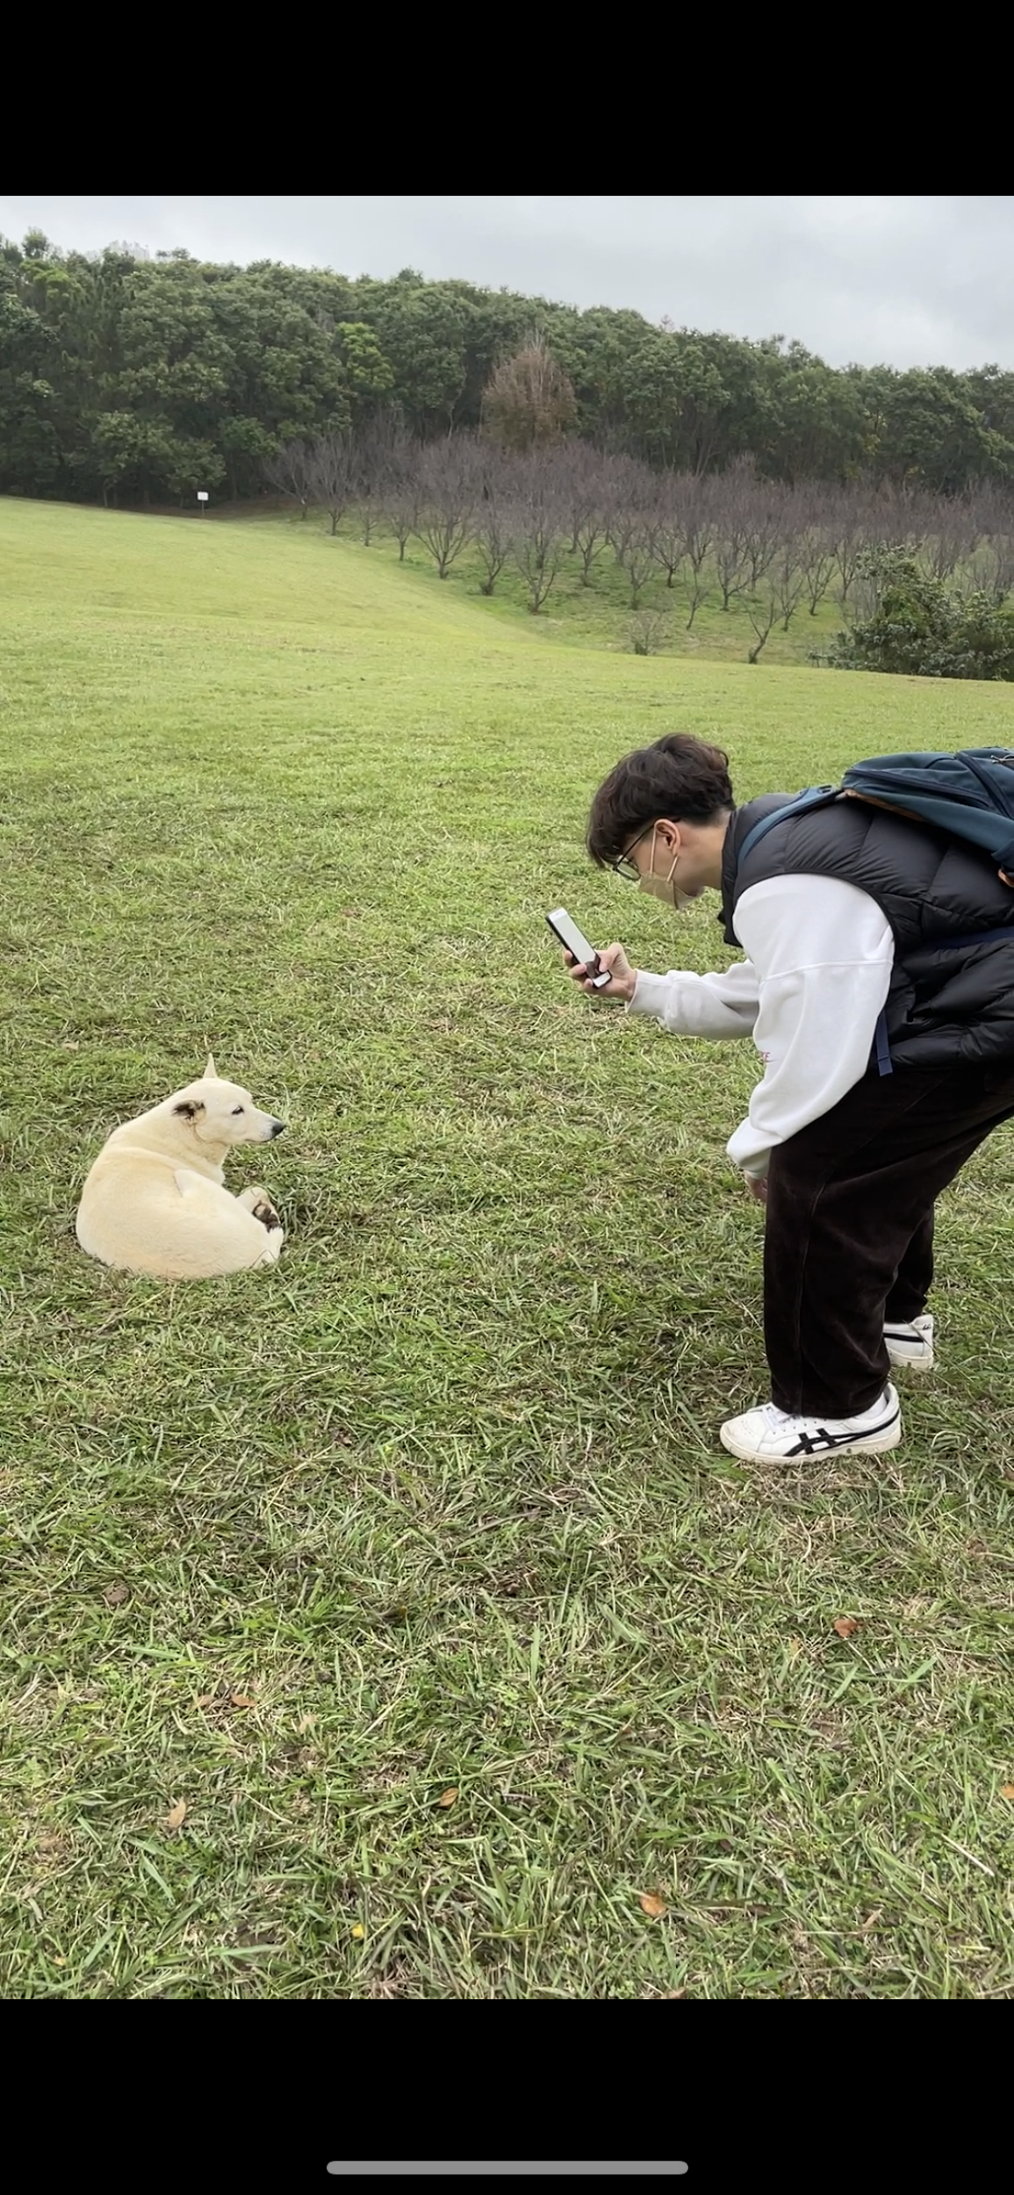
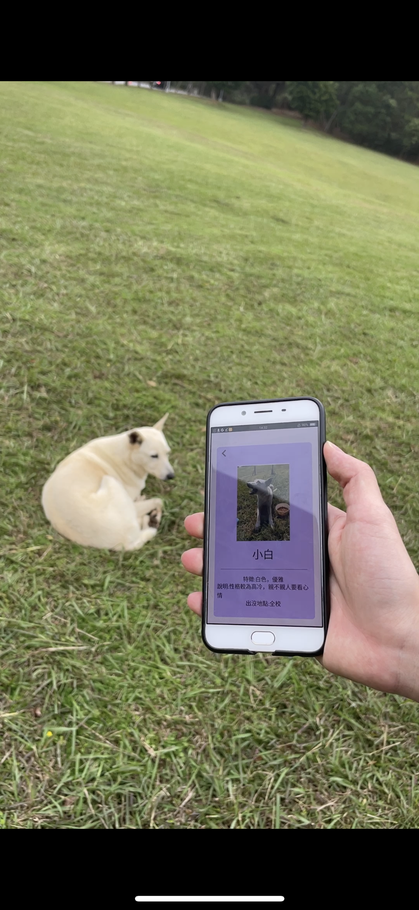
More Examples

Slide 27
Difficulties

Slide 28
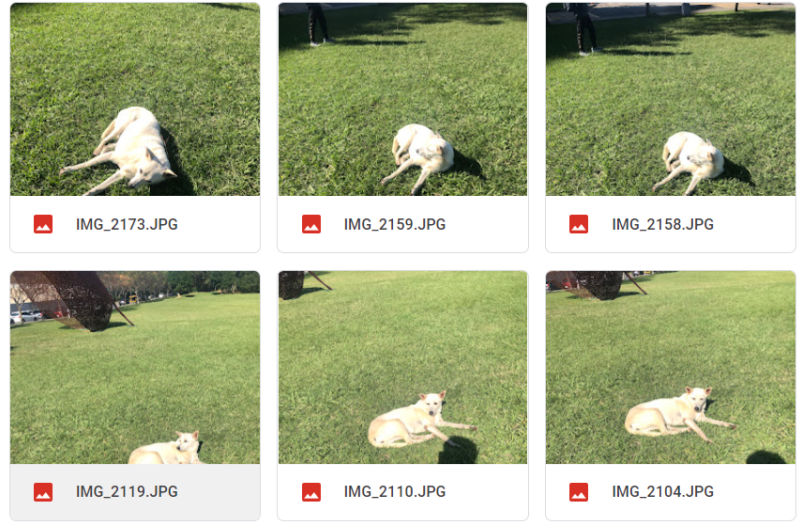
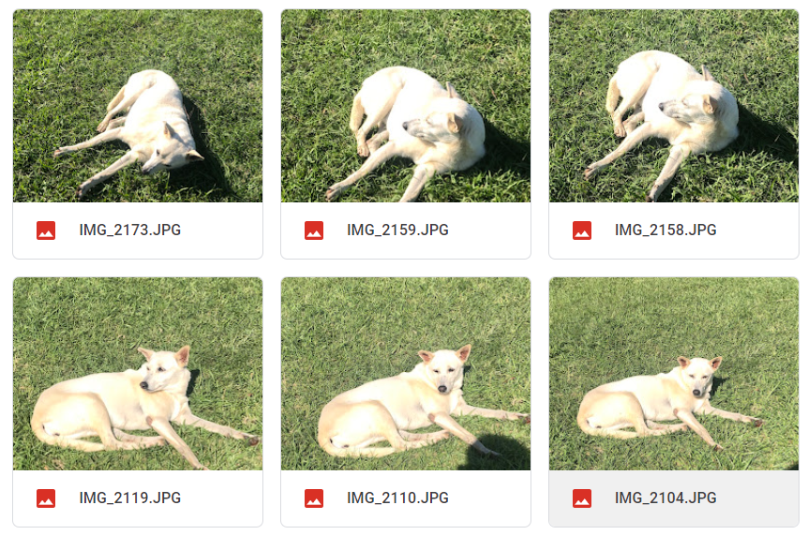
Feature extraction
Bad feature extraction due to large background
cannot locate dog correctly
output depends heavily on background
large area of background
focus more on animals

Slide 29
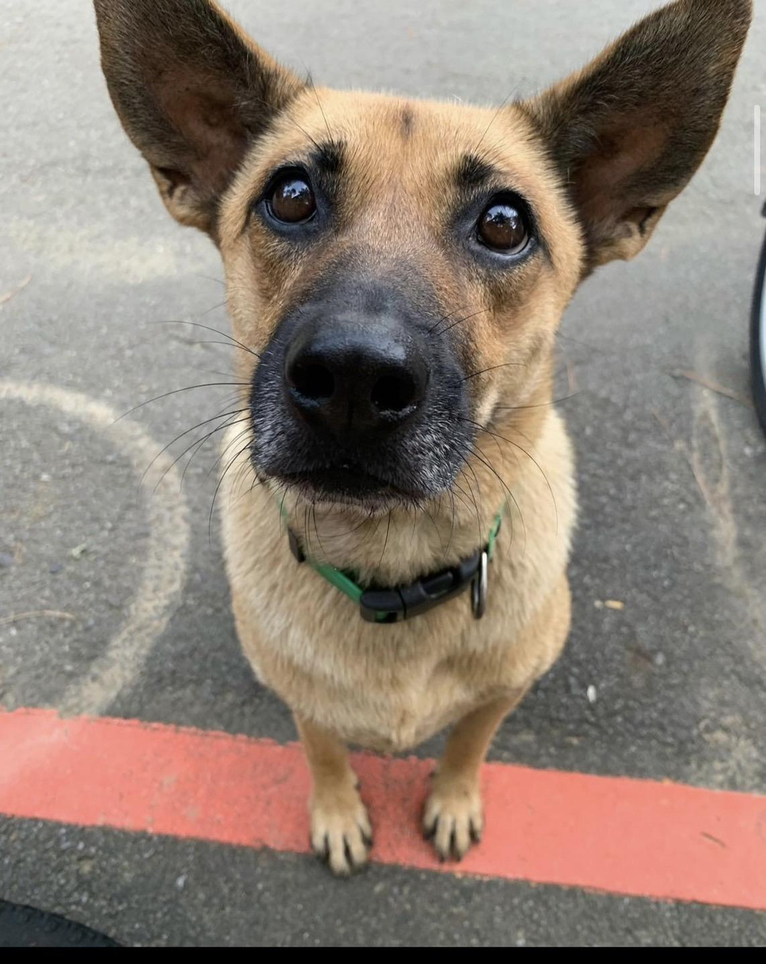
Thank you

